Slide 1
ATAI
Advanced Techniqueof Artificial Intelligence
ATAI
ChongqingUniversity _{AdvancedTechniqueof}
of Technology Artificial Intelligence
Chongqing University of
Technology
Chongqing University ^{ATAI}
_{of Technology} Advanced Techniqueof
Artificial Intelligence
Chongqing University of Technology
Chongqing University of Technology
Adaptive Graph Learning for Multimodal Conversational Emotion Detection
Adaptive Graph Learning for Multimodal Conversational Emotion Detection
—— AAAI 2024
Code:https://github.com/TuGengs/AdaIGN
Reported by Tingting Zhang
1

Slide 2
ATAI
AdvancedTechniqueof
Artificial Intelligence
ATAI
ChongqingUniversity _{AdvancedTechniqueof}
of Technology Artificial Intelligence
ChongqingUniversity of Technology
Motivation
(1) Previous approaches in modeling intra-modal interactions have often relied on using future utterances to predict the current one’s emotion.
(2) The difficulty of balancing empathy and emotional inertia.
(3) Multimodal information involves content with conflicting emotions.
Notes:
1. 未来的话语可能会影响当前话语的情感检测，但先前的方法往往依赖于使用未来的话语来预测当前话语的情感，这在实际情况中并不实用。
2. 在平衡同理心和情感惯性方面存在困难。对话的情感动态涉及到自我依赖（情感惯性）和人际依赖（同理心）两个方面，而在建模内部模态交互时，平衡同理心和情感惯性之间的关系是一个重大挑战。
3. 多模态信息涉及到具有冲突情感的内容，但现有研究尚未解决这种差异。

Slide 3
ChongqingUniversity of Technology
ATAI
AdvancedTechniqueof
Artificial Intelligence
ATAI
ChongqingUniversity _{AdvancedTechniqueof}
of Technology Artificial Intelligence
Overview

Slide 4
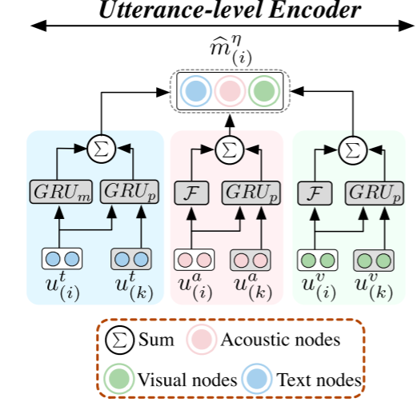
ChongqingUniversity of Technology
ATAI
AdvancedTechniqueof
Artificial Intelligence
ATAI
ChongqingUniversity _{AdvancedTechniqueof}
of Technology Artificial Intelligence
Method
Utterance-level Encoder

Slide 5
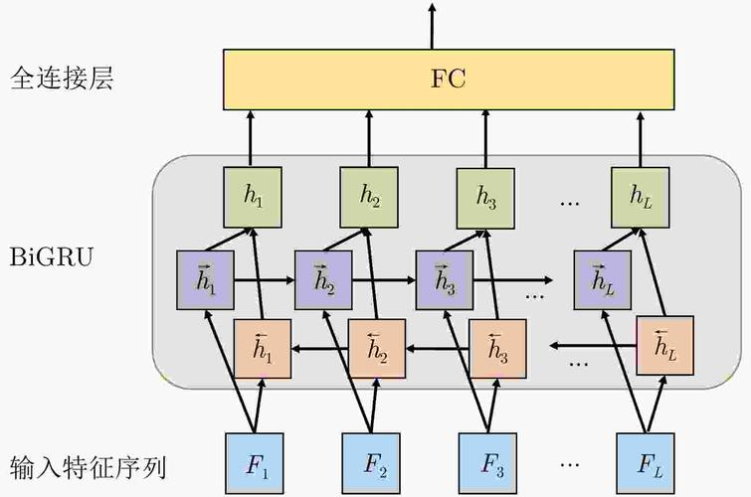
ChongqingUniversity of Technology
ATAI
AdvancedTechniqueof
Artificial Intelligence
ATAI
ChongqingUniversity _{AdvancedTechniqueof}
of Technology Artificial Intelligence
Method

Slide 6
ChongqingUniversity of Technology
ATAI
AdvancedTechniqueof
Artificial Intelligence
ATAI
ChongqingUniversity _{AdvancedTechniqueof}
of Technology Artificial Intelligence
Method
Adaptive Interactive Graph Network
Graph Structure
Gumbel Softmax Sampling
Selection Policies

Slide 7
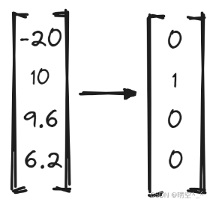
ChongqingUniversity of Technology
ATAI
AdvancedTechniqueof
Artificial Intelligence
ATAI
ChongqingUniversity _{AdvancedTechniqueof}
of Technology Artificial Intelligence
Method
https://www.cnblogs.com/jack-nie-23/p/16565036.html

Slide 8
ChongqingUniversity of Technology
ATAI
AdvancedTechniqueof
Artificial Intelligence
ATAI
ChongqingUniversity _{AdvancedTechniqueof}
of Technology Artificial Intelligence
Method
Adaptive Interactive Graph Network
Pseudo Labels

Slide 9
ChongqingUniversity of Technology
ATAI
AdvancedTechniqueof
Artificial Intelligence
ATAI
ChongqingUniversity _{AdvancedTechniqueof}
of Technology Artificial Intelligence
Method
Adaptive Interactive Graph Network
Graph Convolution Operation

Slide 10
ChongqingUniversity of Technology
ATAI
AdvancedTechniqueof
Artificial Intelligence
ATAI
ChongqingUniversity _{AdvancedTechniqueof}
of Technology Artificial Intelligence
Method
Emotion Classifier

Slide 11
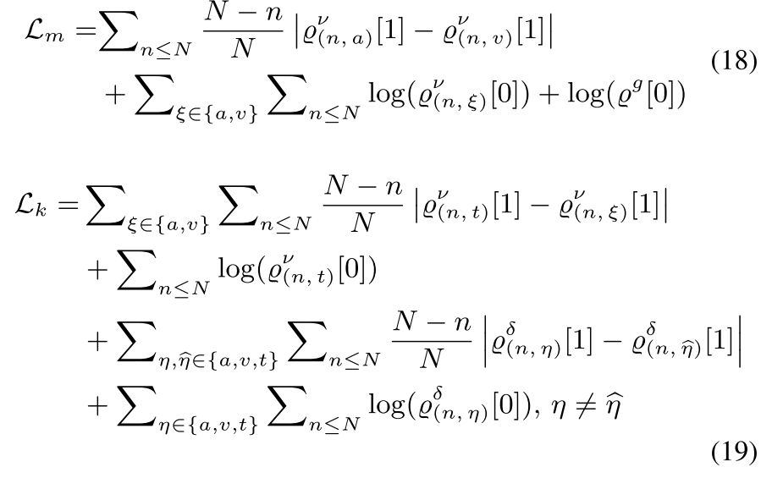
ChongqingUniversity of Technology
ATAI
AdvancedTechniqueof
Artificial Intelligence
ATAI
ChongqingUniversity _{AdvancedTechniqueof}
of Technology Artificial Intelligence
Method
Emotion Classifier
Keeping Loss

Slide 12
ChongqingUniversity of Technology
ATAI
AdvancedTechniqueof
Artificial Intelligence
ATAI
ChongqingUniversity _{AdvancedTechniqueof}
of Technology Artificial Intelligence
Method
Emotion Classifier
Dropping Loss

Slide 13
ATAI
AdvancedTechniqueof
Artificial Intelligence
ATAI
ChongqingUniversity _{AdvancedTechniqueof}
of Technology Artificial Intelligence
ChongqingUniversity of Technology
Experiments

Slide 14
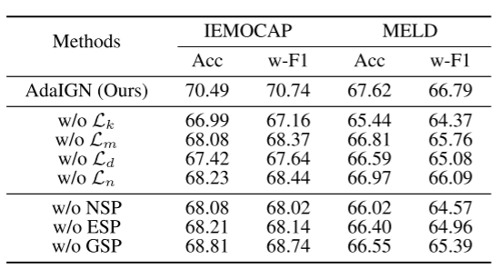
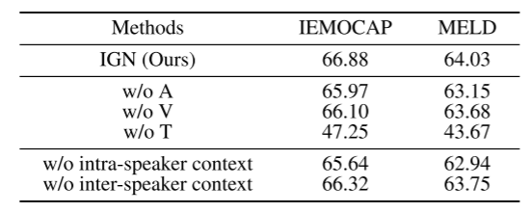
ATAI
AdvancedTechniqueof
Artificial Intelligence
ATAI
ChongqingUniversity _{AdvancedTechniqueof}
of Technology Artificial Intelligence
ChongqingUniversity of Technology
Experiments

Slide 15
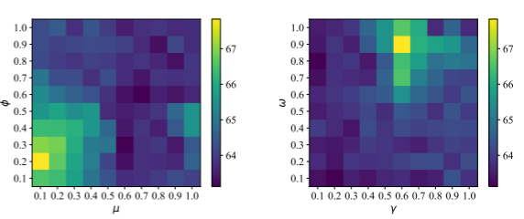
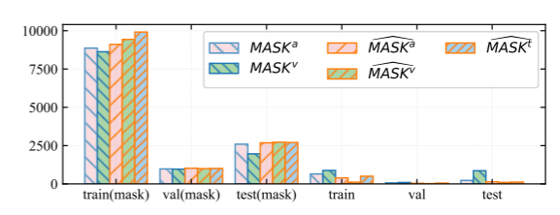
ATAI
AdvancedTechniqueof
Artificial Intelligence
ATAI
ChongqingUniversity _{AdvancedTechniqueof}
of Technology Artificial Intelligence
ChongqingUniversity of Technology
Experiments

Slide 16
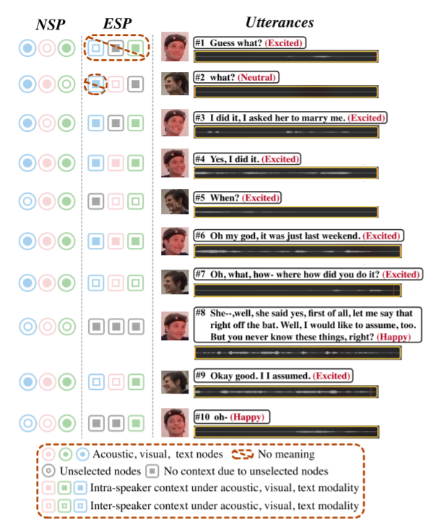
ATAI
AdvancedTechniqueof
Artificial Intelligence
ATAI
ChongqingUniversity _{AdvancedTechniqueof}
of Technology Artificial Intelligence
ChongqingUniversity of Technology
Experiments

Slide 17
ChongqingUniversity of Technology
ATAI
AdvancedTechniqueof
Artificial Intelligence
ATAI
ChongqingUniversity _{AdvancedTechniqueof}
of Technology Artificial Intelligence
Thanks!

